Slide 1
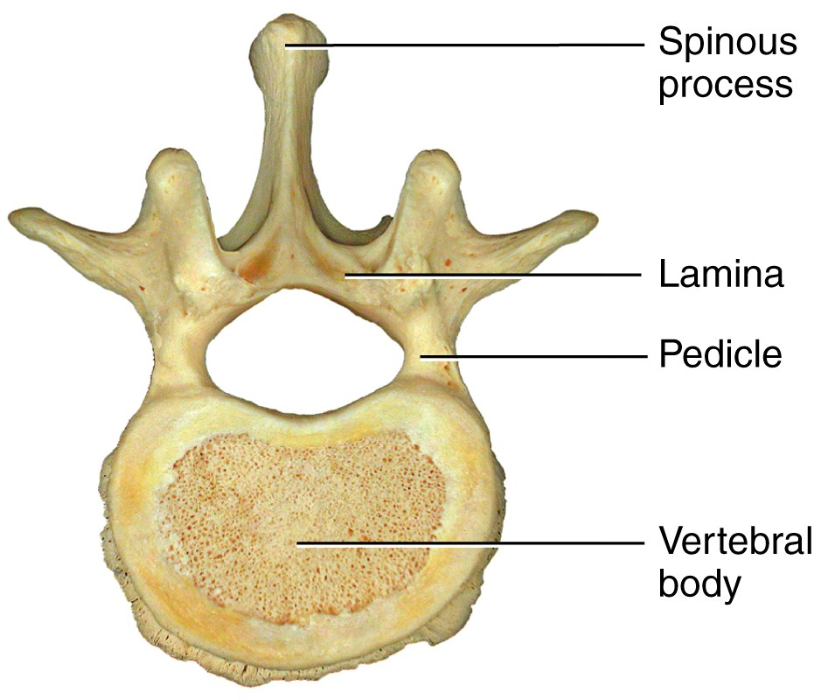
The Vertebral Column
The spine is composed of a series of bones called vertebrae.
Vertebrae typically consist of:
  A body (weight bearing)
  A pedicle and lamina
  forming the vertebral arch
  (surrounds the spinal cord)
  Several processes (points
  of attachment for muscles)

Slide 2
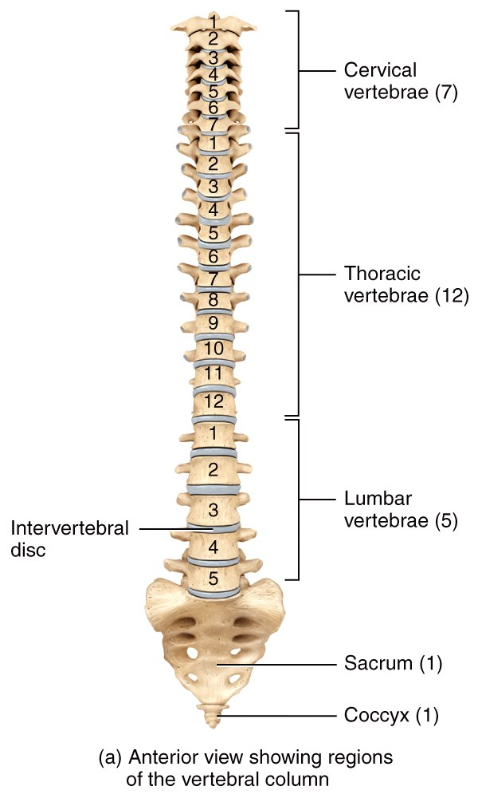
The Vertebral Column
There are 7 cervical vertebrae in the neck region labeled C₁-C_{7 .}
There are 12 thoracic vertebrae that articulate with the ribs (T₁-T₁₂).
There are 5 lumbar vertebrae that support the lower back labeled L₁-L₅ .
The sacrum and coccyx are single bones that result from the fusion of several vertebrae.

Slide 3
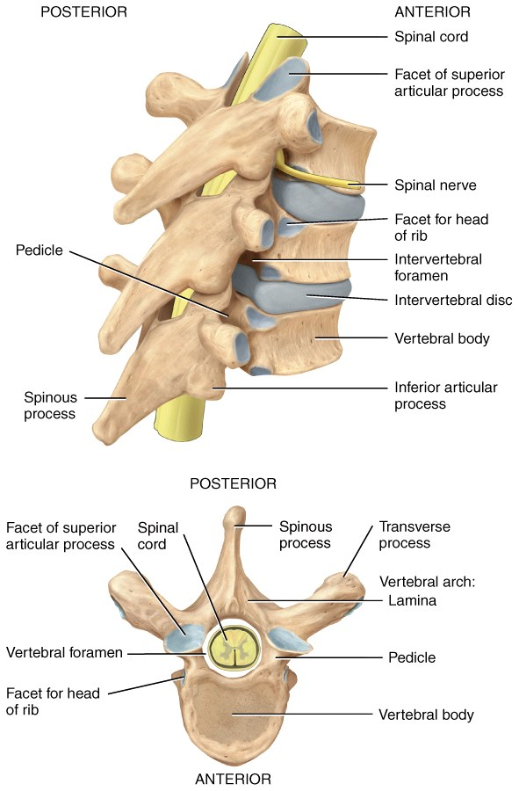
The Vertebral Column
From the cervical region to the sacrum, each vertebra has a large central hole, or vertebral foramen in which the spinal cord can travel.
At each segmental level, on both the right and left sides, an intervertebral foremen is formed for the exiting spinal nerves.

Slide 4
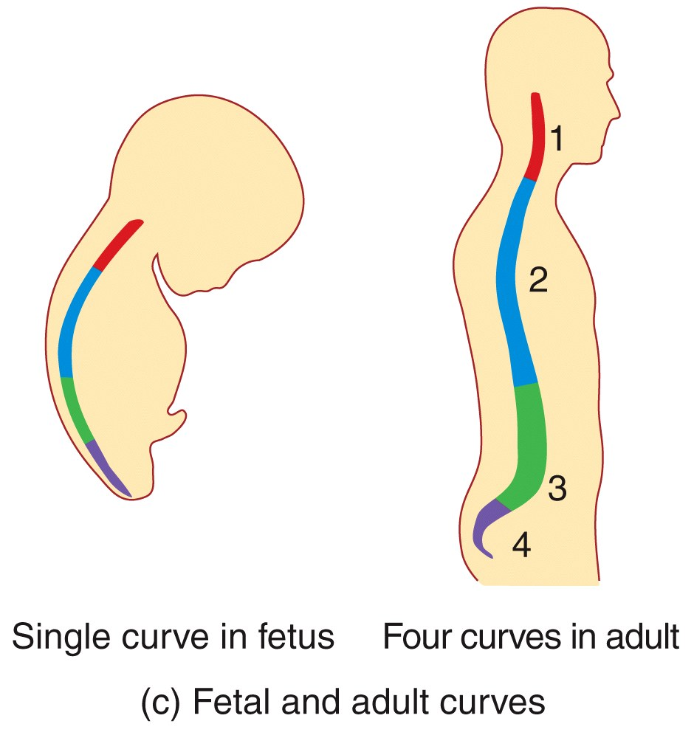
The Vertebral Column
When viewed from the front, a normal adult vertebral column appears straight.
When viewed from the side,
it has four slight bends which
constitute the normal spinal
curvatures.

Slide 5
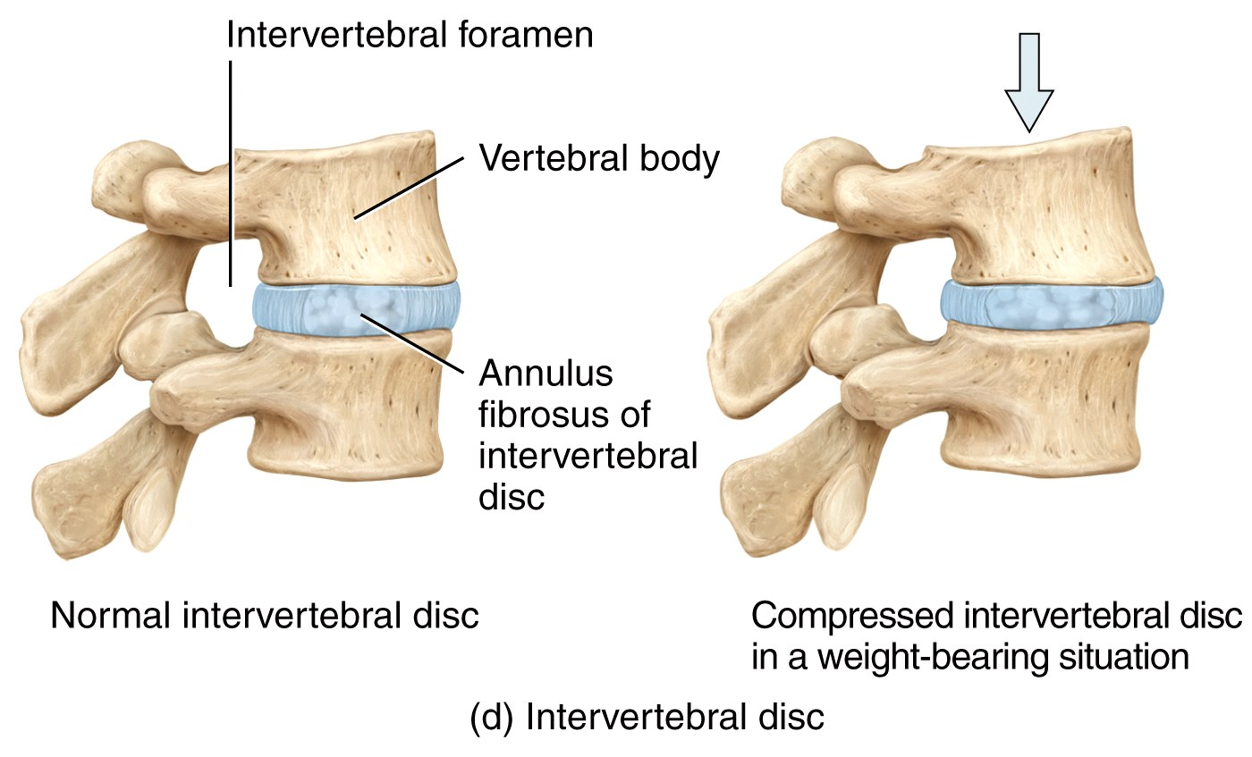
The Vertebral Column
A tough fibrocartilage intervertebral disc is found between the bodies of adjacent vertebrae.
  It functions to absorb vertical shock and form joints which are strong
  yet still permit
  movement
  of the spine.

Slide 6
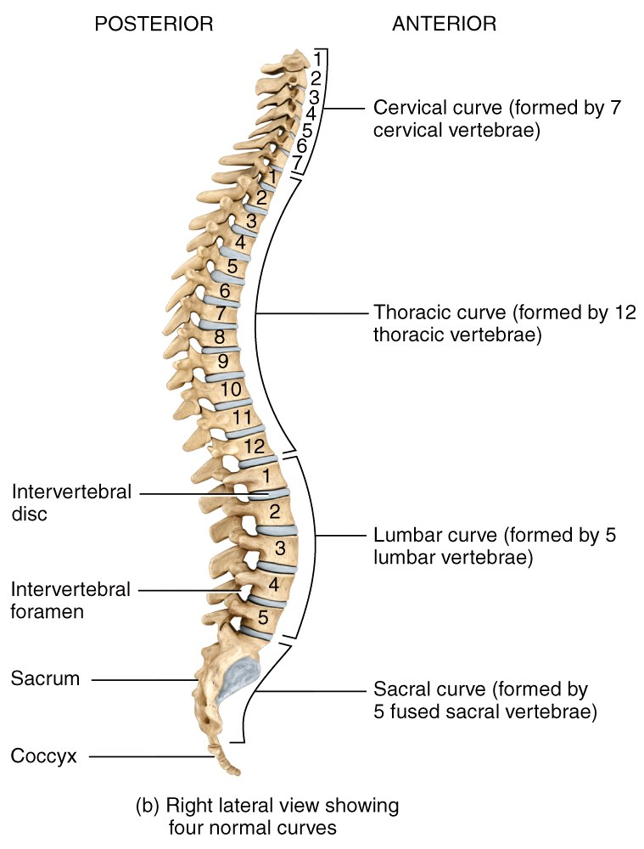
Vertebral Column
Relative to the front of the body, the cervical and lumbar curves are convex (bulging out),
The thoracic and sacral curves are concave (cupping in).

Slide 7
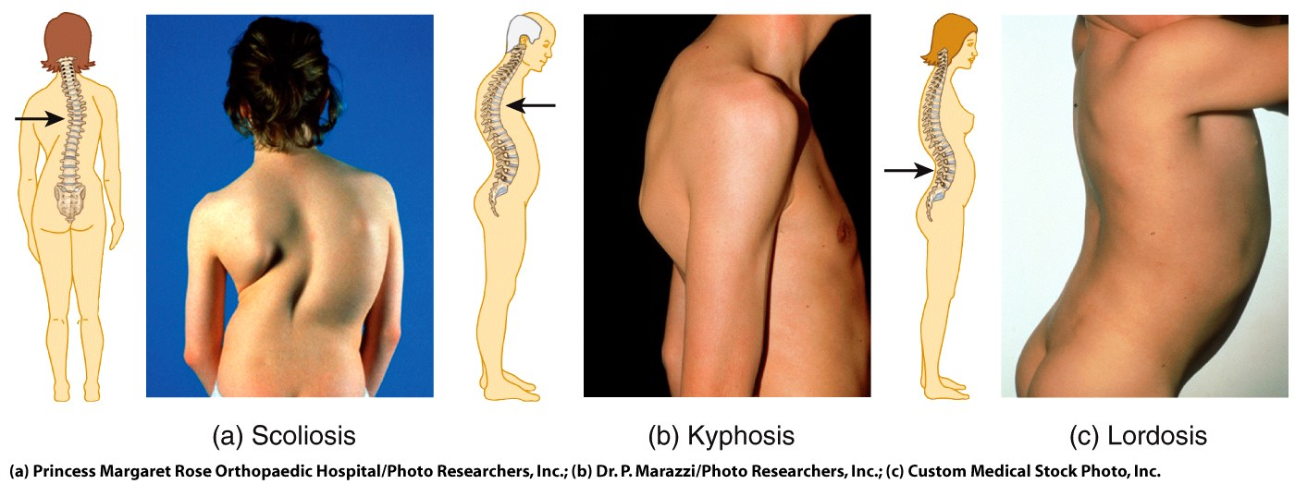
The Vertebral Column
Various conditions may exaggerate the normal spinal curves, sometimes causing severe disability.

Slide 8
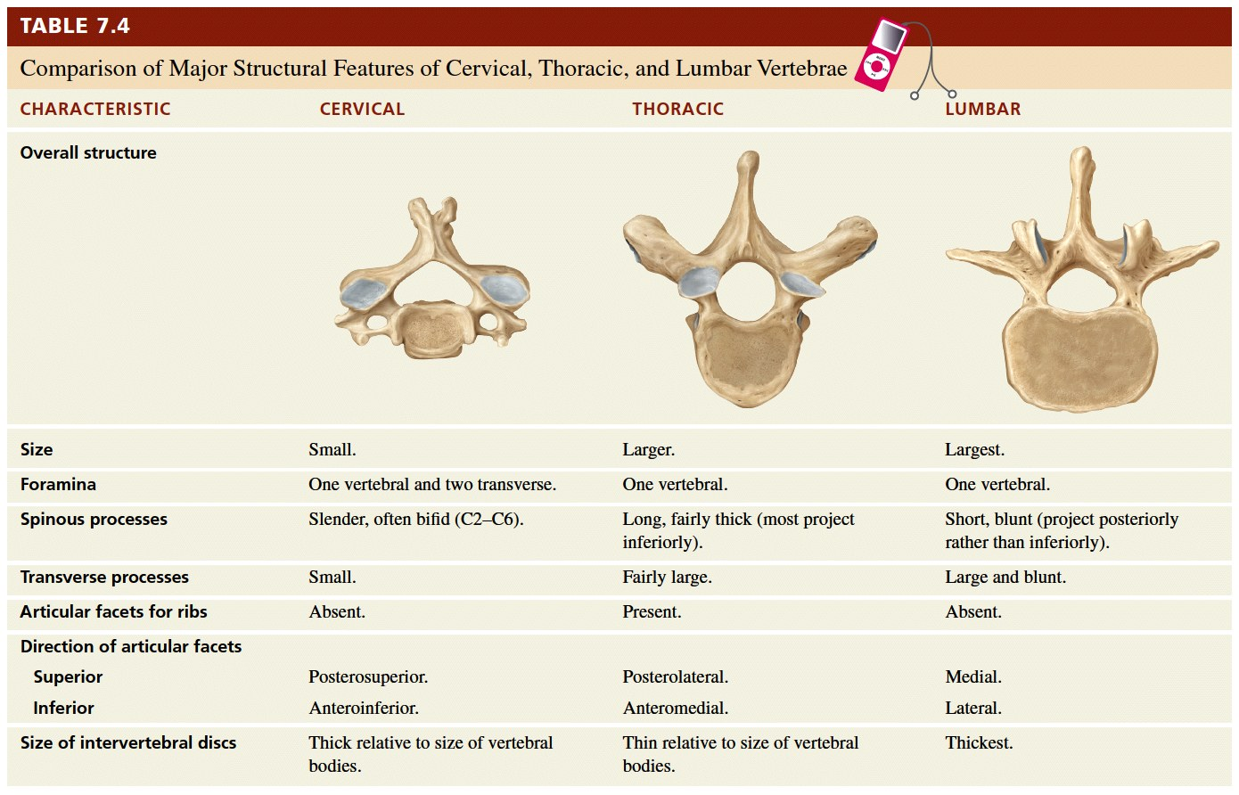
The Vertebral Column

Slide 9
The Vertebral Column
The cervical vertebrae comprise the bony spine in the neck:
  C₁ is called the Atlas because it holds up the head the way the Titan of Greek mythology supported the world.
  C₂ is called the Axis because it provides a pivot, allowing the head to turn on the neck.

Slide 10
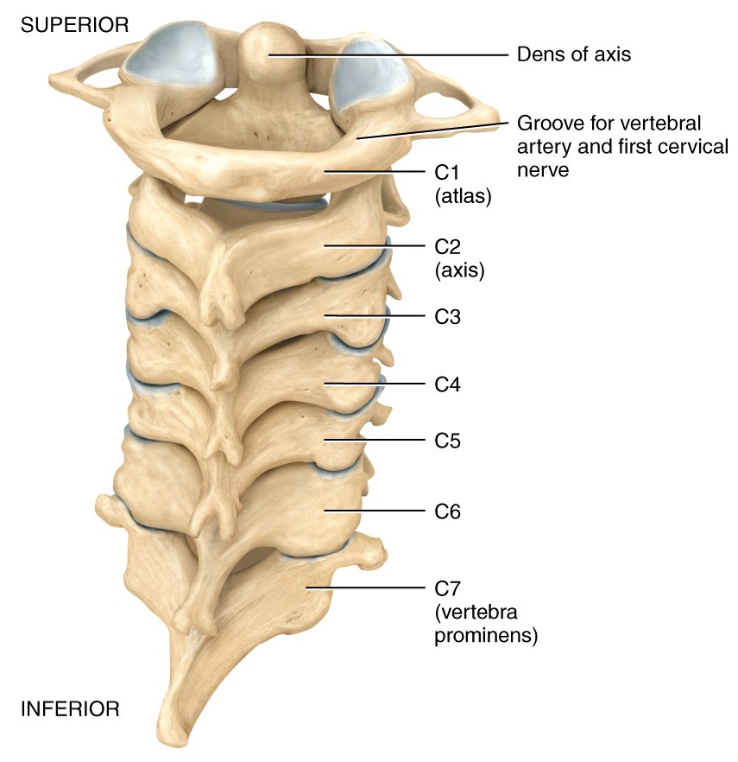
The Vertebral Column
Without these first two specialized cervical vertebra, the head-on-neck range of motion would be very limited.

Slide 11
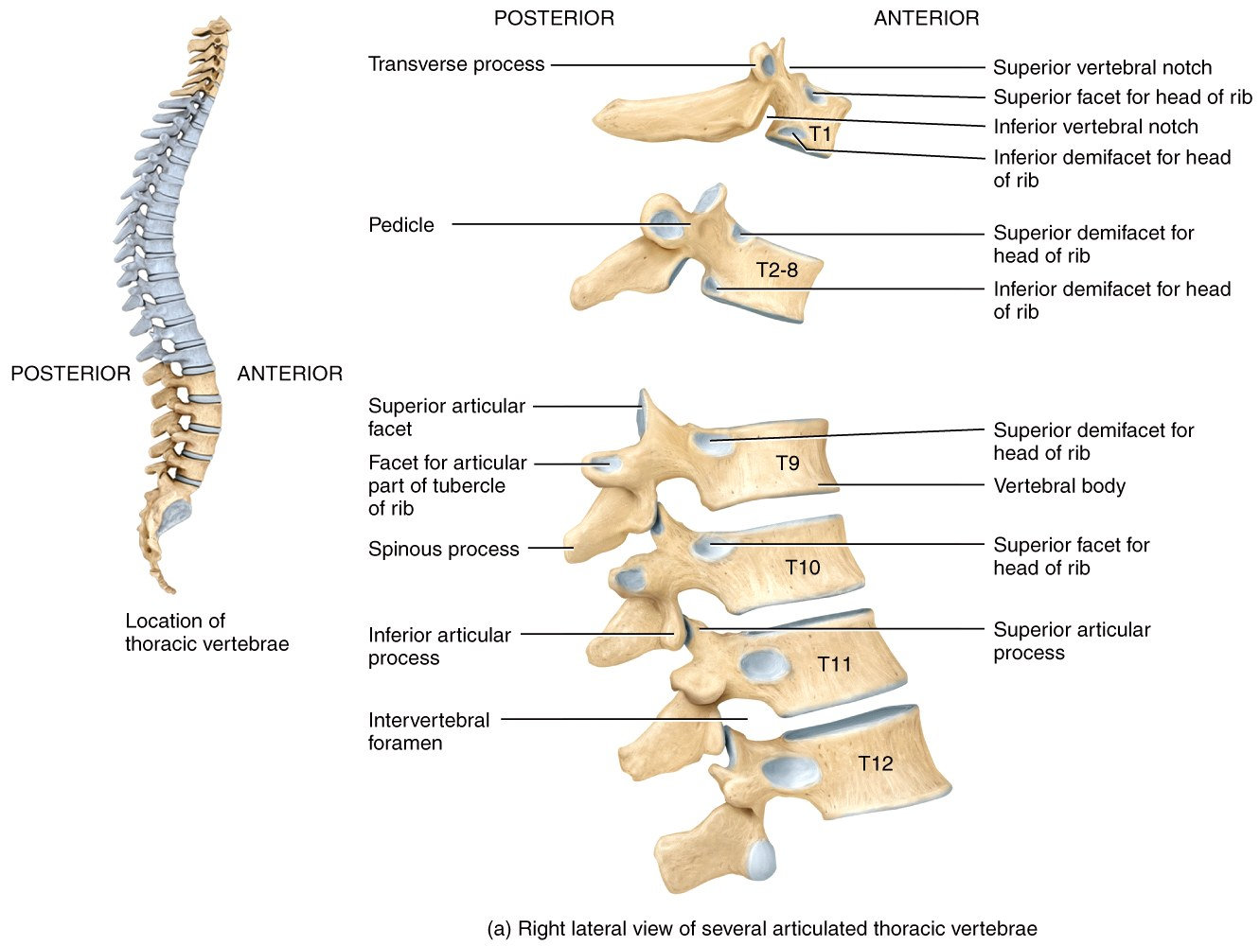
The Vertebral Column
Below the neck, each of the 12 pairs of thoracic vertebrae articulate with a rib to
form the posterior part
of the thoracic cage.

