Slide 1
12
The Central Nervous System: Part D

Slide 2
The Spinal Cord: Embryonic Development
By week 6, there are two clusters of neuroblasts
Alar plate—will become interneurons; axons form white matter of cord
Basal plate—will become motor neurons; axons will grow to effectors
Neural crest cells form the dorsal root ganglia sensory neurons; axons grow into the dorsal aspect of the cord

Slide 3
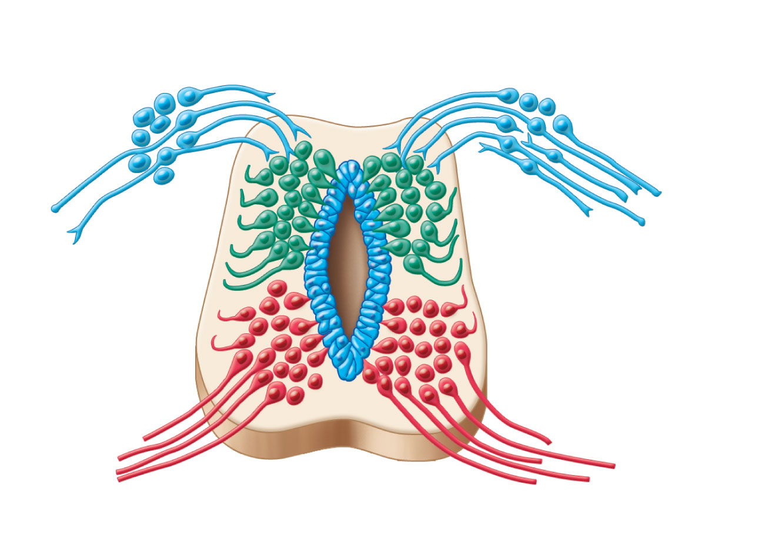
Dorsal root ganglion: sensory
neurons from neural crest
Alar plate:
interneurons
White
matter
Basal plate:
motor neurons
Neural tube
cells
Central
cavity
Figure 12.28

Slide 4
Spinal Cord
Location
Begins at the foramen magnum
Ends as conus medullaris at L₁ vertebra
Functions
Provides two-way communication to and from the brain
Contains spinal reflex centers

Slide 5
Spinal Cord: Protection
Bone, meninges, and CSF
Cushion of fat and a network of veins in the epidural space between the vertebrae and spinal dura mater
CSF in subarachnoid space

Slide 6
Spinal Cord: Protection
Denticulate ligaments: extensions of pia mater that secure cord to dura mater
Filum terminale: fibrous extension from conus medullaris; anchors the spinal cord to the coccyx

Slide 7
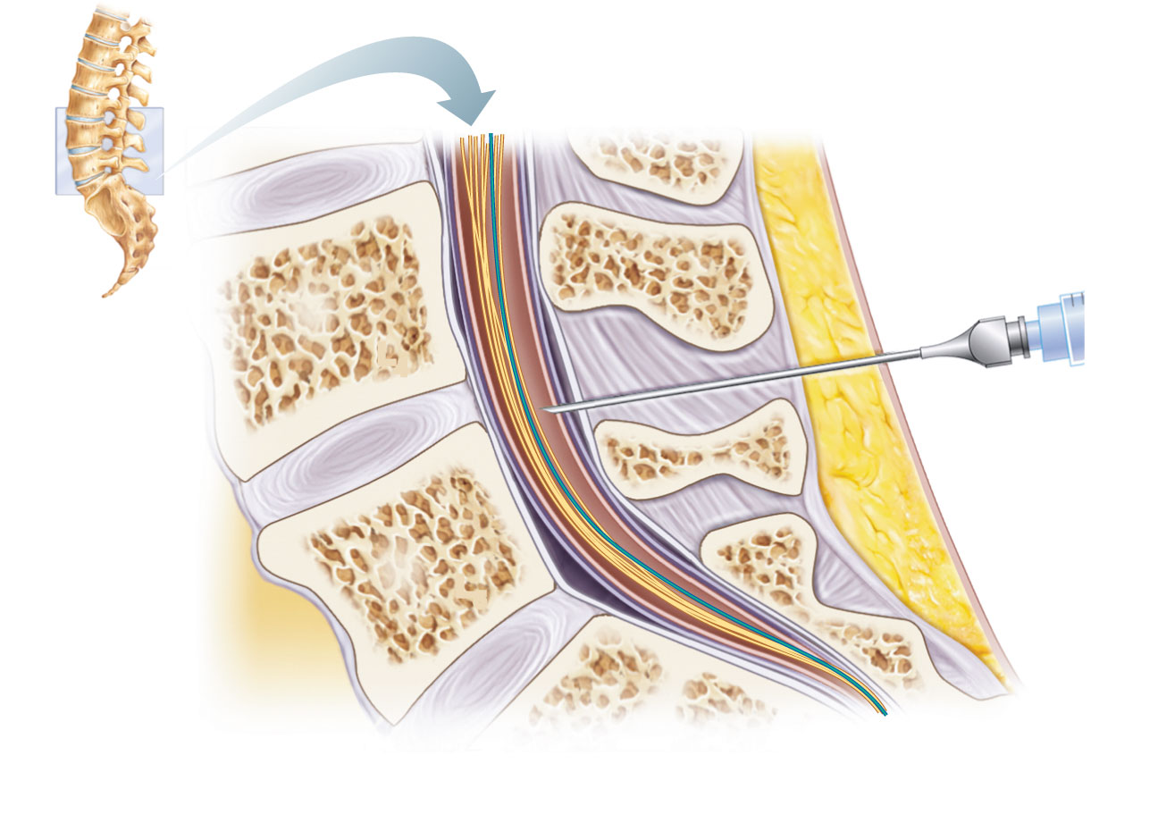
T₁₂
Ligamentum
flavum
L₅
Lumbar puncture
needle entering
subarachnoid
space
L₄
Supra-
spinous
ligament
L₅
Filum
terminale
S₁
Inter-
vertebral
disc
Cauda equina
in subarachnoid
space
Arachnoid
matter
Dura
mater
Figure 12.30

Slide 8
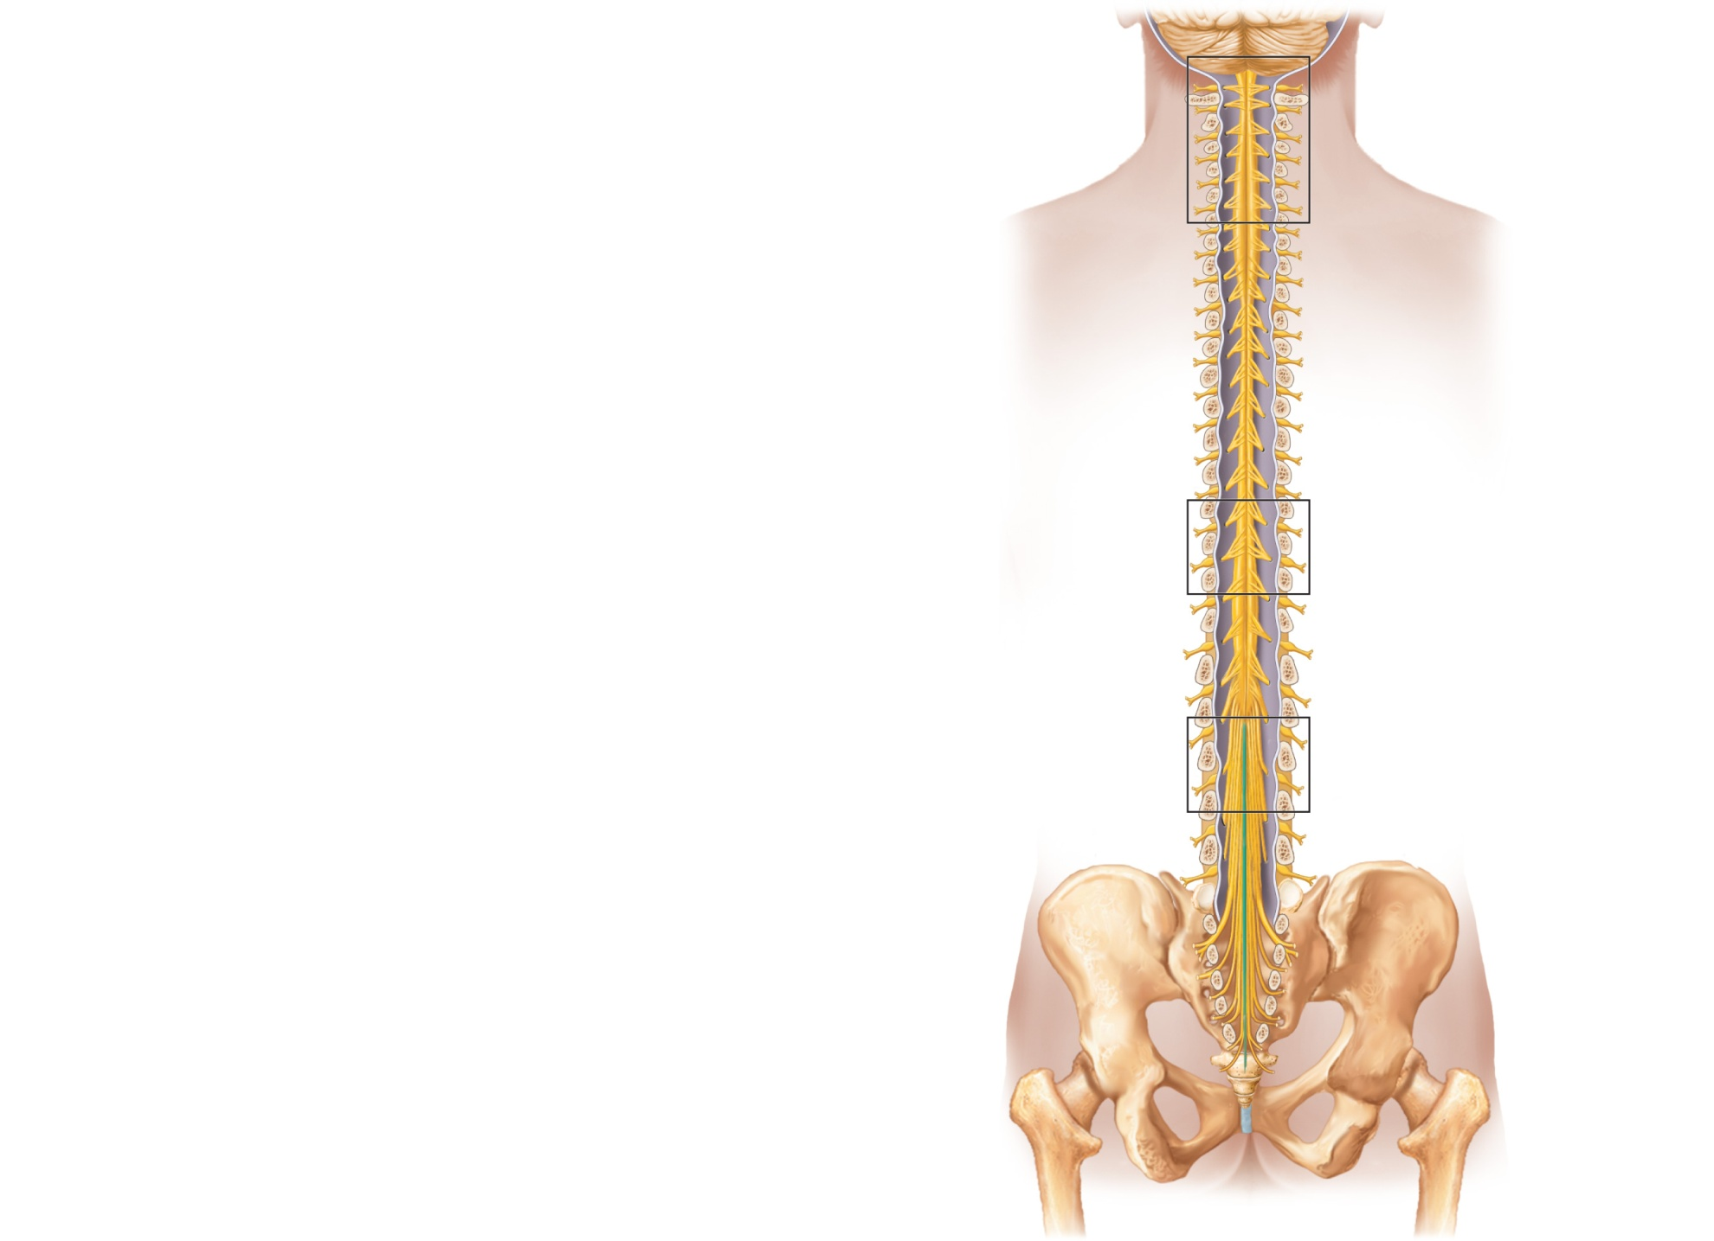
Cervical
spinal nerves
Cervical
enlargement
Dura and
arachnoid
mater
Thoracic
spinal nerves
Lumbar
enlargement
Conus
medullaris
Cauda
equina
Lumbar
spinal nerves
Filum
terminale
(a) The spinal cord and its nerve
roots, with the bony vertebral
arches removed. The dura mater
and arachnoid mater are cut
open and reflected laterally.
Sacral
spinal nerves
Figure 12.29a

Slide 9
Spinal Cord
Spinal nerves
31 pairs
Cervical and lumbar enlargements
The nerves serving the upper and lower limbs emerge here
Cauda equina
The collection of nerve roots at the inferior end of the vertebral canal

Slide 10
Cross-Sectional Anatomy
Two lengthwise grooves divide cord into right and left halves
Ventral (anterior) median fissure
Dorsal (posterior) median sulcus
Gray commissure—connects masses of gray matter; encloses central canal

Slide 11
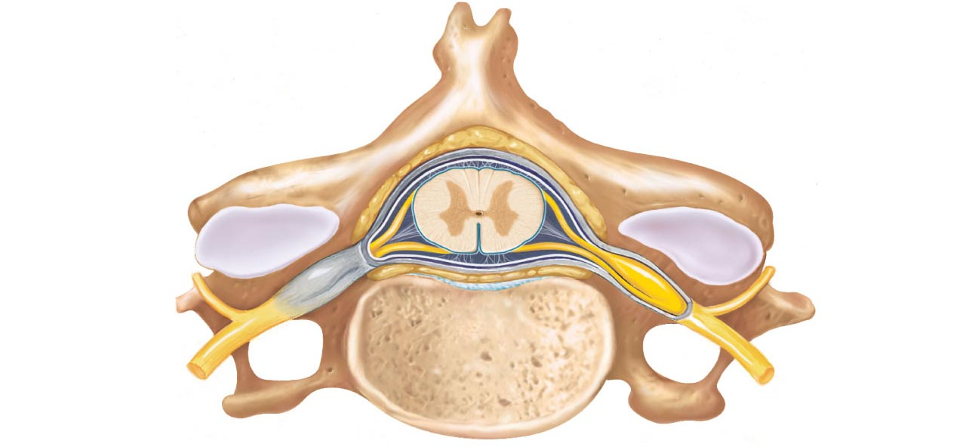
Epidural space
(contains fat)
Pia mater
Arachnoid
mater
Spinal
meninges
Subdural space
Dura mater
Subarachnoid
space
(contains CSF)
Bone of
vertebra
Dorsal root
ganglion
Body
of vertebra
(a) Cross section of spinal cord and vertebra
Figure 12.31a

Slide 12
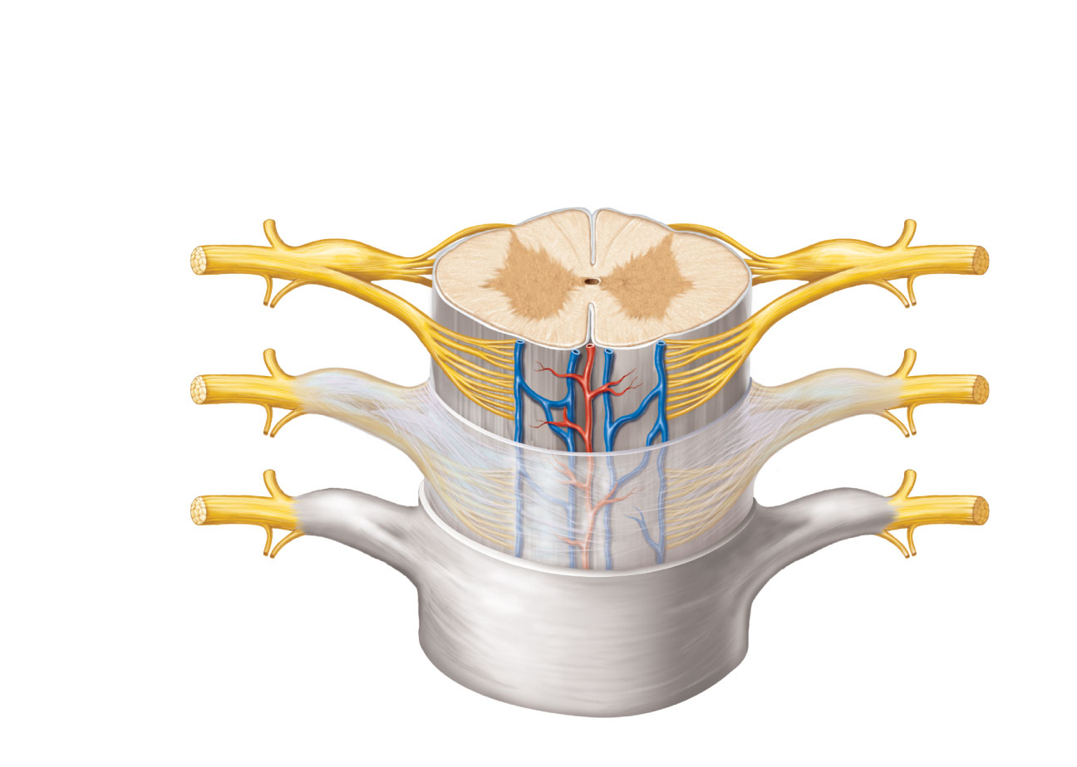
Dorsal median sulcus
Gray
commissure
Dorsal funiculus
White
columns
Ventral funiculus
Dorsal horn
Gray
matter
Ventral horn
Lateral funiculus
Lateral horn
Dorsal root
ganglion
Spinal nerve
Central canal
Dorsal root
(fans out into
dorsal rootlets)
Ventral median
fissure
Ventral root
(derived from several
ventral rootlets)
Pia mater
Arachnoid mater
Spinal dura mater
(b) The spinal cord and its meningeal coverings
Figure 12.31b

Slide 13
Gray Matter
Dorsal horns—interneurons that receive somatic and visceral sensory input
Ventral horns—somatic motor neurons whose axons exit the cord via ventral roots
Lateral horns (only in thoracic and lumbar regions) –sympathetic neurons
Dorsal root (spinal) gangia—contain cell bodies of sensory neurons

Slide 14
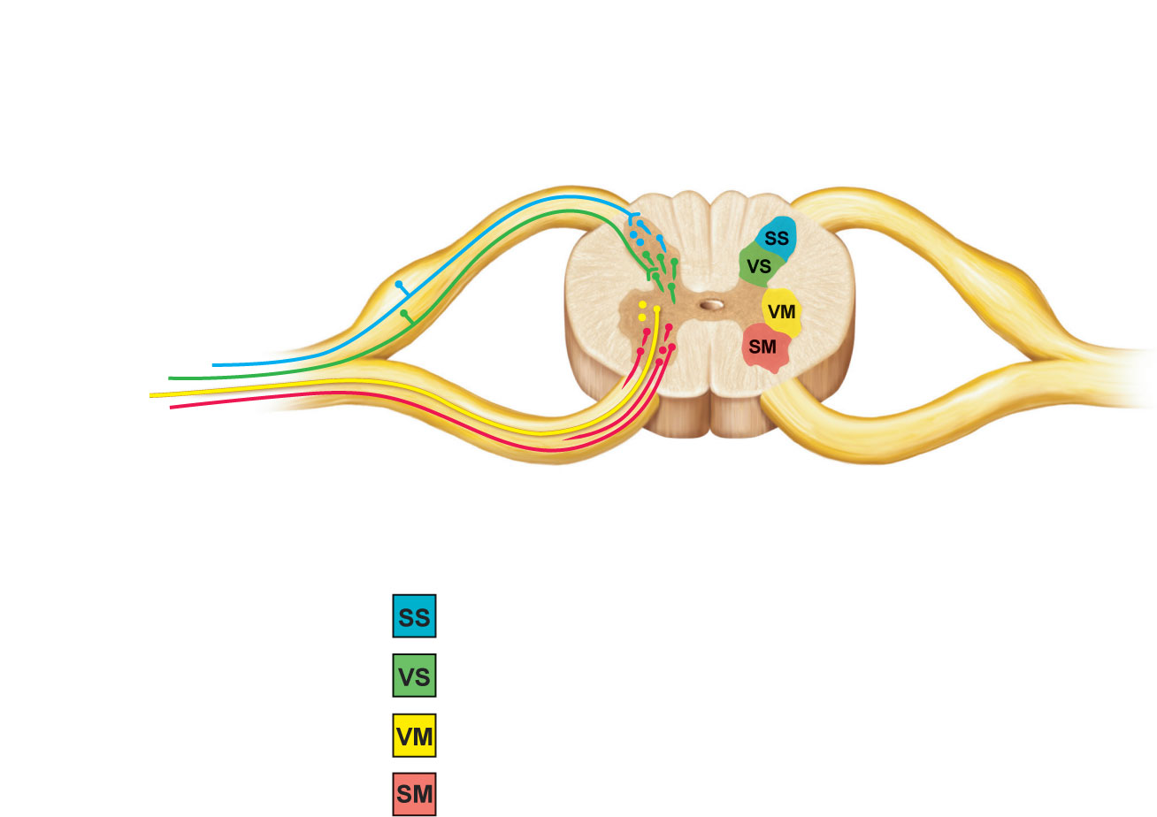
Dorsal root (sensory)
Dorsal root ganglion
Dorsal horn (interneurons)
Somatic
sensory
neuron
Visceral
sensory
neuron
Visceral
motor
neuron
Spinal nerve
Ventral horn
(motor neurons)
Ventral root
(motor)
Somatic
motor neuron
Interneurons receiving input from somatic sensory neurons
Interneurons receiving input from visceral sensory neurons
Visceral motor (autonomic) neurons
Somatic motor neurons
Figure 12.32

Slide 15
White Matter
Consists mostly of ascending (sensory) and descending (motor) tracts
Transverse tracts (commissural fibers) cross from one side to the other
Tracts are located in three white columns (funiculi on each side—dorsal (posterior), lateral, and ventral (anterior)
Each spinal tract is composed of axons with similar functions

Slide 16
Pathway Generalizations
Pathways decussate (cross over)
Most consist of two or three neurons (a relay)
Most exhibit somatotopy (precise spatial relationships)
Pathways are paired symmetrically (one on each side of the spinal cord or brain)

Slide 17
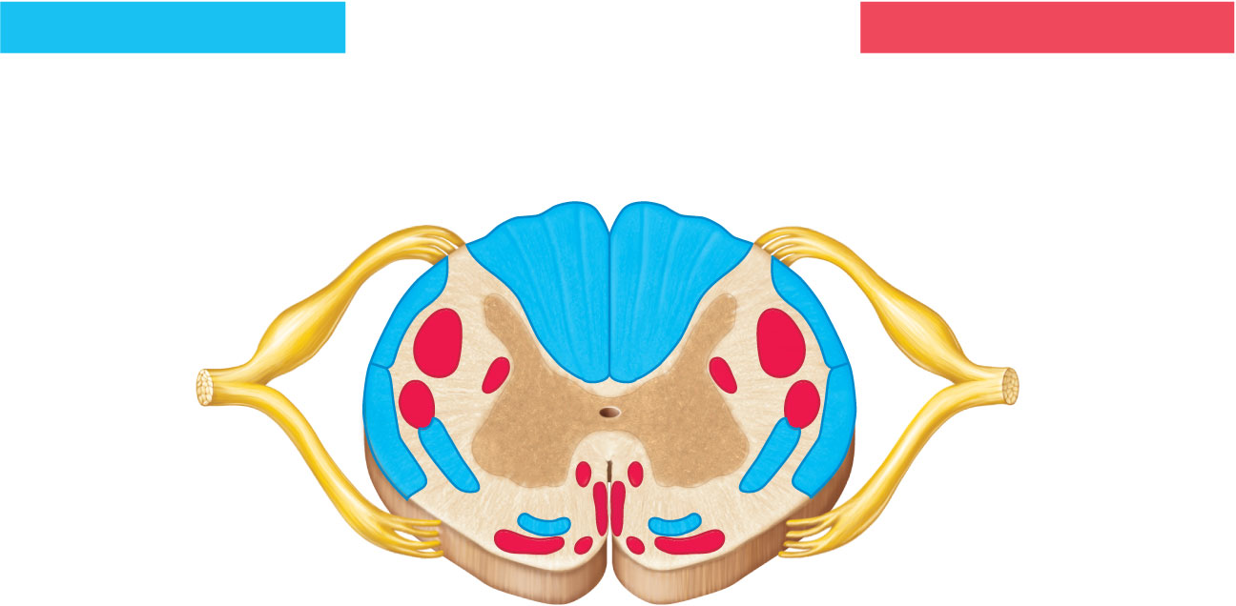
Ascending tracts
Descending tracts
Fasciculus gracilis
Ventral white
commissure
Dorsal
white
column
Fasciculus cuneatus
Lateral
reticulospinal tract
Dorsal
spinocerebellar
tract
Lateral
corticospinal tract
Rubrospinal
tract
Ventral
spinocerebellar
tract
Medial
reticulospinal
tract
Lateral
spinothalamic tract
Ventral corticospinal
tract
Ventral spinothalamic
tract
Vestibulospinal tract
Tectospinal tract
Figure 12.33

Slide 18
Ascending Pathways
Consist of three neurons
First-order neuron
Conducts impulses from cutaneous receptors and proprioceptors
Branches diffusely as it enters the spinal cord or medulla
Synapses with second-order neuron

Slide 19
Ascending Pathways
Second-order neuron
Interneuron
Cell body in dorsal horn of spinal cord or medullary nuclei
Axons extend to thalamus or cerebellum

Slide 20
Ascending Pathways
Third-order neuron
Interneuron
Cell body in thalamus
Axon extends to somatosensory cortex

Slide 21
Ascending Pathways
Two pathways transmit somatosensory information to the sensory cortex via the thalamus
Dorsal column-medial lemniscal pathways
Spinothalamic pathways
Spinocerebellar tracts terminate in the cerebellum

